Slide 1
iCreate - Generative Design in Architecture
Group 61: Hannah Solorzano, Nabeel Shariff, Rhea Mae Edwards

Slide 2
Project’s Purposes and Goals
Rhea Mae
Intuitive user interface and generative design
Offer a user a way to turn sketches and gestures into complex 3D objects and structures
Allow the user to interact with the virtual environment

Slide 3
Project’s Current State
Nabeel
User Interface
Generation and Modification 3D Objects
Creation of Mathematical Curves
Spawning of 3D Objects along Curves
Save and Load

Slide 4
Impeded Problems and Solutions
Nabeel
Client Confusion and Indirectness
Assignment of Tasks
Documentation and Implementation Expectations
Work through with assistance from TA and instructors
Personal Dilemmas
Exhaustion of Energy
Time Limited
Staying Motivated, Pushed Through
Sought Out Help and Assistance

Slide 5
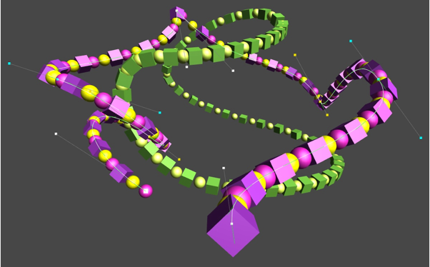
Preliminary Results
Hannah
Spawning 3D objects along a generated curve
Parabola and Hyperbola trajectories
Ellipse and Circular trajectories
Bezier and B-spline trajectories
[1]
Flick, Jasper. “Curves and Splines.” Catlike Coding, catlikecoding.com/unity/tutorials/curves-and-splines/.

Slide 6
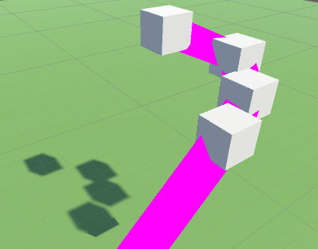
Interesting Pieces of Code
Hannah
Bezier construction
Handles and Transforms VS Points

Slide 7
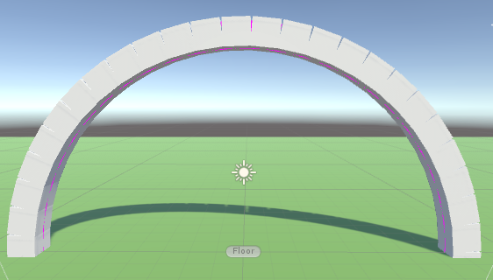
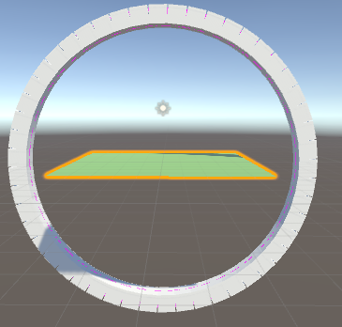
Interesting Pieces of Code
Hannah
Circle Trajectory
Rotation along the path

Slide 8
Final Trajectory Results
Hannah
Circle and Ellipse
Circle and Ellipse demo
Parabola and Hyperbola
Parabola and Ellipse demo
Bezier and B-Spline
Bezier and B-Spline demo

Slide 9
First User Study/Individual Testing
Rhea Mae
Individual Testing with Personal HTC Vive Headsets
By Nabeel and Hannah
Testing during development

Slide 10
Retrospective of the Last 10 Weeks
Rhea Mae
Positives: anything good that happened
Completed the majority of project
Beta Version
Video Demonstrations
Design Document Approved
Deltas: changes that need to be implemented
Stitching functionalities into one
Appropriate fixes and updates
Actions: specific actions that will be implemented in order to create necessary changes
Code Modifications
Program Testing
Constant Researching

Slide 11
...
Video Demonstration of Current Project Implementation
(Beta Version)
...

